Slide 1
Database Design

Slide 2
Day 4

Slide 3
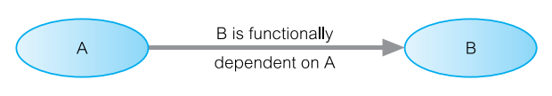
Functional Dependencies
Constraint that determines the relationship of one attribute to another
For every relation R, attribute B is functionally dependent on attribute A, if value of A can uniquely determine the value of B
FD representation: A → B
Determinant: Attribute or group of attributes on LHS of FD diagram
Dependent: Attribute or group of attributes on RHS of FD diagram
Notes:
For the purposes of normalization, identify functional dependencies between attributes of a relation that have a one to one relationship between the attributes

Slide 4
Full, Partial and Transitive Dependency
Full Functional Dependency: A and B are attributes of a relation, B is fully functionally dependent on A, if B is functionally dependent on A, but not on any proper subset of A.
Partial Dependency: A→B is a partial dependency if there are some attribute than be removed from A and yet the dependency still holds.
Transitive Dependency: A, B and C are attributes of a relation such that A→B and B→C , then C is transitively dependent on A via B.

Slide 5
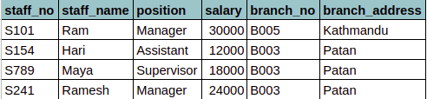
Functional Dependency Examples
staff_no ---> staff_name, position, salary, branch_no, branch_address
branch_no, position ---> salary
branch_no ---> branch_address
branch_address ---> branch_no
staff_no, branch_no ---> branch_address
staff_no ---> branch_no ---> branch_address
Notes:
For the purpose of discussion, let’s assume
Data is not time variant, ie. staff has only one position and only works in a branch
One branch can exist only in one district
position held in a branch determines the salary, example: staff out of valley are provided extra bonuses

Slide 6
Second Normal Form (2NF)
An entity type is in second normal form (2NF) when
It is in 1NF
All the non prime attributes don’t have partial dependency.
Second Normal Form applies to relations with composite keys, i.e. relations with a primary key composed of two or more attributes
A relation with single-attribute primary key is automatically in at least 2NF
Notes:
For the relational model, it is important to recognize that it is only 1NF that is critical in creating relations, all subsequent normal forms are optional.
To avoid anomalies, we process upto 3NF
Every non primary key is fully functionally dependent on the primary key

Slide 7
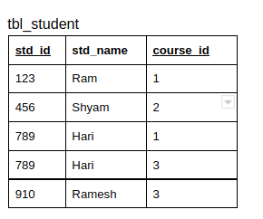
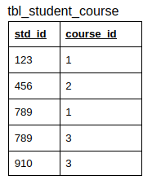
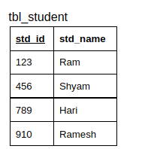
2NF Example:
Consider a table in 1NF
Candidate key: {std_id, course_id}
Non prime attribute: std_name
Since, std_name is dependent on std_id, which is a subset of candidate key, partial dependency exists and this table is not in 2NF.
Converting it to 2NF:
In tbl_student, std_name is fully dependent on std_id
In tbl_student_course, std_id and course_id form candidate key, and no non prime attributes are present.

Slide 8
Third Normal Form (3NF)
An entity type is in third normal form (3NF) when
It is in second normal form
Transitive dependency is not present
In other words, prime attribute can determine non-prime attribute but that non prime attribute should not determine another non-prime attribute
Example: X -> Y -> Z where,
X is prime attribute
Y is non-prime attribute
Z is non-prime attribute
This is called transitive dependency.

Slide 9
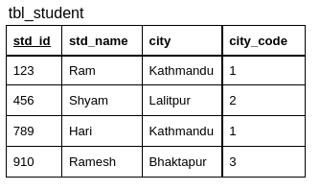
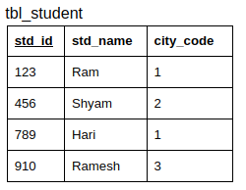
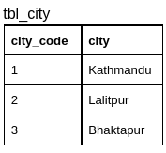
3NF Example
Consider a table in 2NF
std_id (PK) is determining std_name however, city_code is determining city, since both city_code and city are non-primary attributes the table is not in 3NF.
Converting it to 3NF:

Slide 10
Boyce-Codd Normal Form (BCNF)
A relation is in BCNF if and only if every determinant is a candidate key.
BCNF is based on functional dependencies that take into account all candidate keys in a relation.
To test whether a relation is in BCNF, identify all the determinants and make sure that they are candidate keys.
BCNF is a stronger form of 3NF, such that every relation in BCNF is also in 3NF.
Difference between 3NF and BCNF is that for A→B, the functional dependency exist even if A is not a candidate key. But for BCNF, A must be a candidate key.
Violation of BCNF is rare and it may happen only under certain conditions
Relation contains two or more composite keys or
Candidate keys overlap, i.e. at least one attribute in common

Slide 11
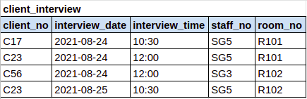
BCNF Example:
The table represents information about client interviews. Staff involved in an interview are allocated a specific room on a day of interview. A client is interviewed only once a day but can have further interview on later dates. However a room might be allocated to several staffs throughout the day.
Candidate Keys: (client_no, interview_date), (staff_no, interview_date, interview_time), (room_no, interview_date, interview_time)
Functional Dependencies:
client_no, interview_date ---> interview_time, staff_no, room_no (PK)
staff_no, interview_date, interview_time ---> client_no (CK)
room_no, interview_date, interview_time ---> staff_no, client_no (CK)
staff_no, interview_date ---> room_no
Notes:
Given table is in 3NF
staff_no, interview_date ---> room_no is not in BCNF as staff_no, interview_date is not candidate key
Update Anomaly: To update the room_no for SG5 on 2021-08-24, 2 rows must be updated
Convert into BCNF by reducing the relation

Slide 12
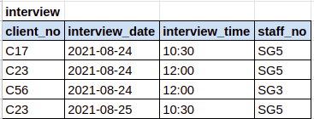
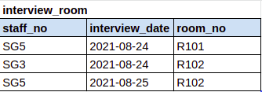
BCNF Example:
It is not always desirable to transform a relation to BCNF
Decision on whether to stop at 3NF or proceed to BCNF is dependent upon the amount of redundancy
For example, if a staff conducts only one interview per day, relation won’t have redundancy and decomposition to BCNF is not helpful.

Slide 13
Physical Data Model
Notes:
Logical database design is concerned with what, physical database design is concerned with how
Physical design is tailored to a specific DBMS
Physical design phase is not an isolated activity, there is often feedback between physical, logical
For example, decision taken during physical design phase such as merging relationships together might affect the structure of logical data model
Steps include from designing base relations to tuning the database
Main objectives of physical database design is to store and access data in an efficient manner

Slide 14
Physical Model Implementation
Once normalization is complete, pretty much everything is ready for implementation
Transform the database from blueprint into an actual functioning database
Steps for Physical Model Implementation
Choosing the database
Choosing names and standards to follow while naming database objects as well as writing queries: Leapfrog Standard
Finalize the implementation keys for the model
Determining domains: Choosing data type, nullability
Setting up schemas: setting up groups of database objects for usage and security
Creating database objects
Notes:
Relations in logical model were validated to ensure that they were correctly structured using the technique of normalization
Follow standards for consistency

Slide 15
DBMS Software Selection
Selection of DBMS software is critical to the information system’s smooth functioning
Advantages and limitations of the proposed DBMS software should be carefully studied.
Factors that affect the selection of DBMS
Cost: Original purchase price, maintenance cost,
DBMS Feature and Tools:

Slide 16
Choosing the right datatype
One datatype might be more efficient than another of similar type
Example: Integer data can be stored in an integer datatype, numeric datatype, floating-point datatype, or even varchar type, but these data types are certainly not alike in implementation or performance.
For large table just saving few bytes makes difference
Bytes Saved | Rows | Total Storage Saved
8 | 10,000,000 | 76 MB
8 | 1,000,000,000 | 7.6 GB
16 | 10,000,000 | 153 MB
16 | 1,000,000,000 | 15.3 GB
Notes:
Important to choose the best possible datatype when building the column

Slide 17
Implicit Conversion Performance Issues
Implicit Conversion: Conversion from one data type to another to be able to make a comparison and that conversion wasn’t specified in the query.
Implicit conversion can impact performance if the conversion has to be applied to every row to perform the comparison
Example: Suppose user_id is stored as string in a table and the query supplies the user_id as integer
SELECT *
FROM playlist
WHERE user_id IN (101,102);
Notes:
Important to choose the best possible datatype when building the column

Slide 18
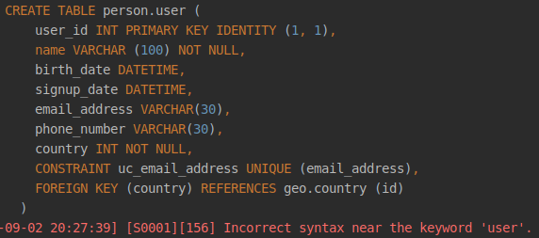
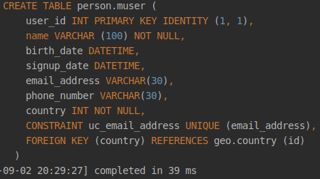
Example Scenario: Creating base relations
Notes:
Database object names cannot be reserved keyword
Maintaining database constraints differs according to the type of DBMS

Slide 19
Representation of Derived Data
Derived Attributes: whose value can be found out by examining other attributes
Example Scenario:
Age of muser
Total number of songs release by an artist
Whether to store a derived attribute of calculate each time depends on
Additional cost to store the derived data
Cost to calculate it each time
Notes:
Number of followers of an artist, number of monthly listeners
Often derived attributes do not appear in the logical model
Choose the less expensive option

Slide 20
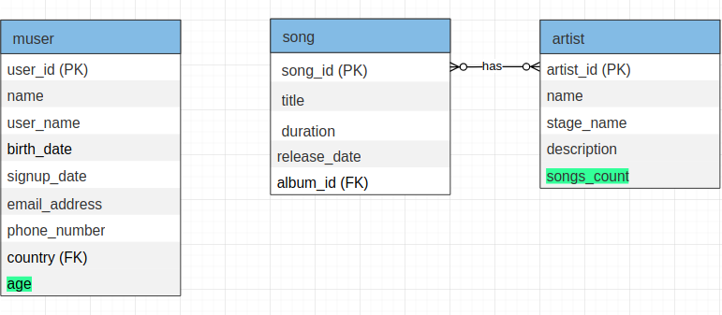
Example Scenario: Derived Data
Notes:
2 kinds of derived data
One is dependent of self, without needing any joins
Another requires join, every time song is updated, update should be made in artist too

Slide 21
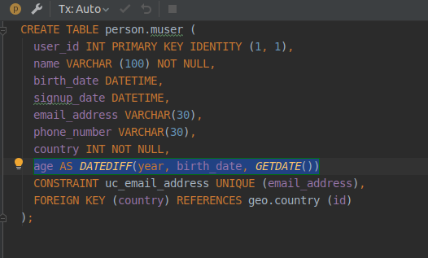
Derived Data using Computed Column
Notes:
2 types of columns:
Implemented: physical storage is always allocated
Computed: columns made from derivation, may be stored or calculated only when accessed
Designing general constraints
How to prevent free user to only have 50 playlist?
Besides these, optimization and monitoring needs to be done

Slide 22
Denormalization
Denormalization is a strategy used on a previously-normalized database to increase performance.
It is a database optimization technique in which we add redundant data to one or more tables.
As a general rule of thumb, if performance is unsatisfactory and relation has a low update and high query rate, denormalization may be a viable option.
Why Denormalization?
Retrieving data is faster since fewer joins are required.
Queries to retrieve data can be simpler.
Notes:
Result of normalization is a logical database design that is structurally consistent and has minimal redundancy
Sometimes argued that a normalized database doesn’t provide maximum processing efficiency
Process of attempting to optimize performance of a database by duplicating certain attributes or joining relations together
Relaxing the normalization constraints imposed on the logical model to improve overall performance of the system

Slide 23
Disadvantages of Denormalization
Denormalization may speed up retrievals but can slow down updates.
It is always application specific and needs to be re-evaluated if the application changes.
It can increase the size of relations.

Slide 24

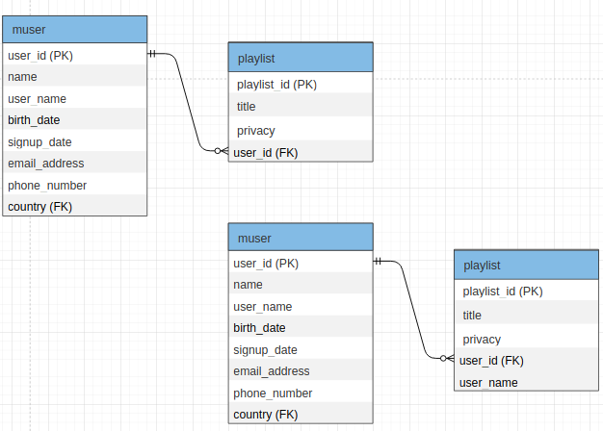
Example Scenario: Denormalization
Given are the ER model from our logical design phase the screenshot of information retrieved while querying the playlist.
Notes:
In the given ER model,user and playlist are the entities
These entities were created during the conceptual and logical design phase and validated through normalization
While fetching the playlist, to get the given output, the playlist has to join with the user entity
If the playlist are searched frequently and our output only needs user_name in created by section, user name can be duplicated in the playlist table itself
Consider the update frequency of user_name, In our case, let’s say once user_name is set, it cannot be updated, so duplicating user name in the playlist itself would reduce the joins and improve performance
Playlist which was a 3NF relation would be then converted into 2NF, as playlist_id→ user_id→ user_name dependency exist.
Additional data storage might be an issue

Slide 25
Thank you ✌

